Slide 1
More about Databases

Slide 2
Data Entry through Forms
Table View (Data sheet view) is useful for data entry of new records
But sometimes customization would be useful or necessary
A form shows only the fields that are needed for the record
Controls security access (fields you don’t need to know exist)

Slide 3
Types of Forms
Detail form (one record at a time)
Multiple items (more than one record)
Split form (form view plus datasheet view)
The Form Wizard can help you create a form easily

Slide 4
Exporting Information
Often you need to transfer data from a database to another application
In Access use External Data
It has ways to export to PDF, Excel, text files
Select the item you want to export – can be a Table, Query, Form, Report
Go to External Data, Export, choose the type of file you want, tell it where to save it

Slide 5
Indexing fields
Access usually does a sequential search when a query is run
Looking at the records one after another
In a large database this takes time
An index on a field that you search for or sort on frequently can speed up the processing
Like a book having an index of words and page numbers

Slide 6
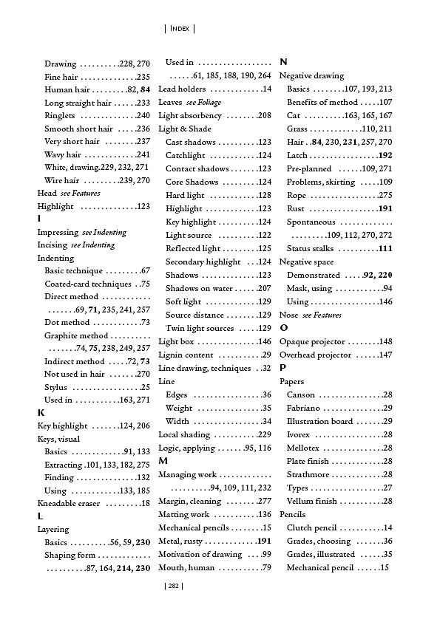

Indexing

Slide 7
More on indexes
Easy to make a field be indexed
Select table where field is
Go to Design View
Click on Field you want indexed
In Field Properties (at bottom) there is a line for Indexed with drop-down menu
  No, Yes (Duplicates ok), Yes (No Duplicates)

Slide 8
Indexes
Primary key field of a table automatically indexed
Indexing is not usually visible during usual database actions
Just improves performance on sorts and searches
Can look at them on Design page, click Indexes on the ribbon
Saved in same file as rest of database objects

Slide 9
Indexes - Disadvantages
Does require a bit more time when doing
  Data entry
  Modifying records
  Deleting records
Why? The index or indexes must be updated when changes are made

